Slide 1

WorkshopPLUS – SQL Server: Performance Tuning and Optimization
{ |  | }
 | SQL Server
<Instructor Name>

Slide 2
Facilities
Class hours
Building hours
Parking
Restrooms
Meals
Phones
Smoking
Recycling

Slide 3

Objectives
After completing SQL Performance Tuning and Optimization workshop, you will be able to:
Learn the following SQL Server performance concepts
SQL Server Architecture, Scheduling and Waits
SQL Server Processor and Memory Management
SQL Server I/O and Database Structure
SQL Server Transactions and Concurrency
SQL Server Index Structure
SQL Server Statistics Structure
SQL Server Query Execution and Plans
SQL Server Plan Caching and Query Store
SQL Server Query Tuning
SQL Server Performance Tools

Slide 4
Agenda Day 1
Task Scheduling
Waits and Queues
Module 1: SQL Server Architecture, Scheduling and Waits
SQL Server Architecture Overview.
SQL Server Operating System (SQLOS) Components.
Understand Common Wait Types
Module 2: SQL Server Processor and Memory Management
Processor Management
Non-Uniform Memory Access (NUMA)
SQL Server Memory Management
Buffer Pool Management
Troubleshooting SQL Server memory

Slide 5
Agenda Day 2
Module 3: SQL Server I/O and Database Structure
TempDB File Structure
SQL Server Transactions
Module 4: SQL Server Transactions and Concurrency
Transaction Isolation Levels
Locking Compatibility
Locking Granularity
Locking Escalation
Blocking and Deadlocking
SQL Server disk I/O operations.
Buffer Pool page cache
Pages and Extents
Data File Structure
Log File Structure
SQL Server Logging Process

Slide 6
Agenda Day 3
Module 5: SQL Server Index Structure
Indexing and SARGability
Index Monitoring
Indexing Strategies
Non-Clustered Indexes
Index Fragmentation
Seeks vs Scans
Heaps vs Clustered Indexes
Module 6: SQL Server Statistics Structure
SQL Server Statistics Internals
SQL Server Statistics Maintenance

Slide 7
Agenda Day 4
Module 7: SQL Server Query Execution and Plans
Query Execution Plans
Query Plan Operators
Module 8: SQL Server Plan Caching and Query Store
SQL Server Plan Cache Internals
Query Store Troubleshooting
Query Optimization and Compilation
Logical vs Physical Join Operators
Troubleshooting Query Plans
Reading Execution Plans
Module 9: SQL Server Query Tuning
Sargable expressions
Extended Events
Overview of Intelligent Query Processing (IQP)

Slide 8
Optional Lessons
Module 10: Optional Lessons
Extra: Test Storage Subsystem with Diskspd
Extra: Troubleshooting TempDB Performance
Extra: Partitioned Tables and Indexes
Extra: Columnstore Indexes
Extra: In-Memory OLTP
Extra: SQL Server Intelligent Query Processing
Extra: SQL Server Resource Governor

Slide 9
Get Ready to Participate
Close email and Update Status
Make it interactive
Check all equipment

Slide 10

Attendee Introductions
Name
Job/Team/Specialty
Time Zone
Experience
Expectations

Slide 11
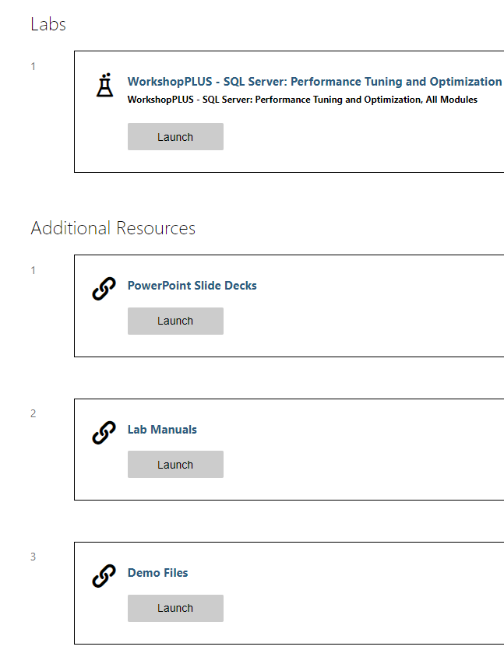
Class Resources
Virtual Lab Environment, Slides Decks, Lab Manuals, and Demo Files
Notes:
http://aka.ms/premiereducation redirects to https://mslearningcampus.com/User/Login?ReturnUrl=%2f
##########

Slide 12
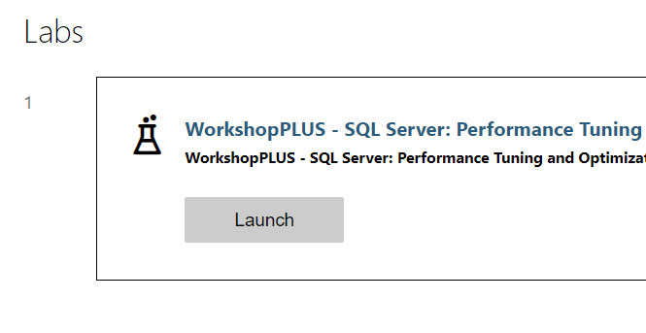
Launch Lab
In the Labs section, click Launch
Notes:
http://aka.ms/premiereducation redirects to https://mslearningcampus.com/User/Login?ReturnUrl=%2f
##########

Slide 13
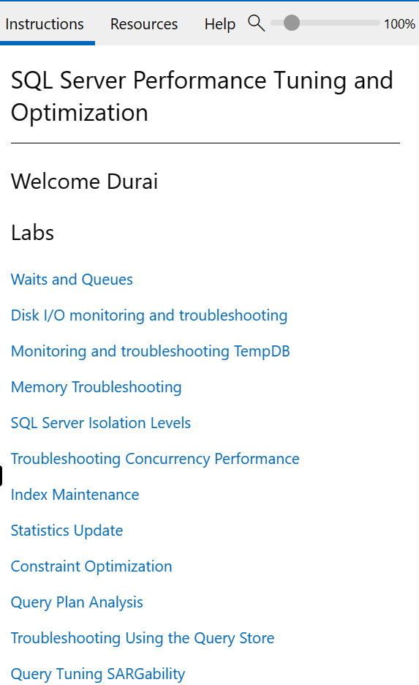
Lab environment
Lab Instructions are shown on the right side of the virtual machine.

Slide 14
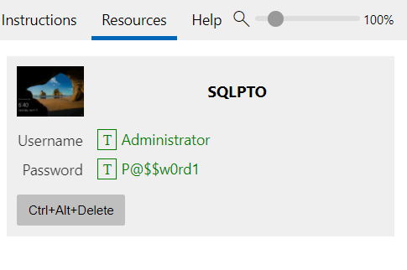
Lab environment
Use the Ctrl+Alt+Delete button to logon to the virtual machine.
You can click on the T next to Username and Password to paste in the virtual machine.

Slide 15
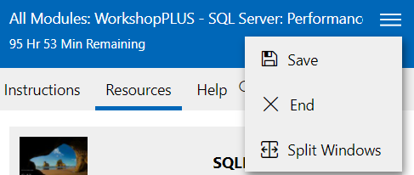
Lab Time Remaining
Ensure you select Save before leaving the Lab environment.
You can save up to 5 labs for up to 7 days.
The lab environment is available for 180 days.
Split Windows will allow you to move the instructions to a separate screen.

Slide 16
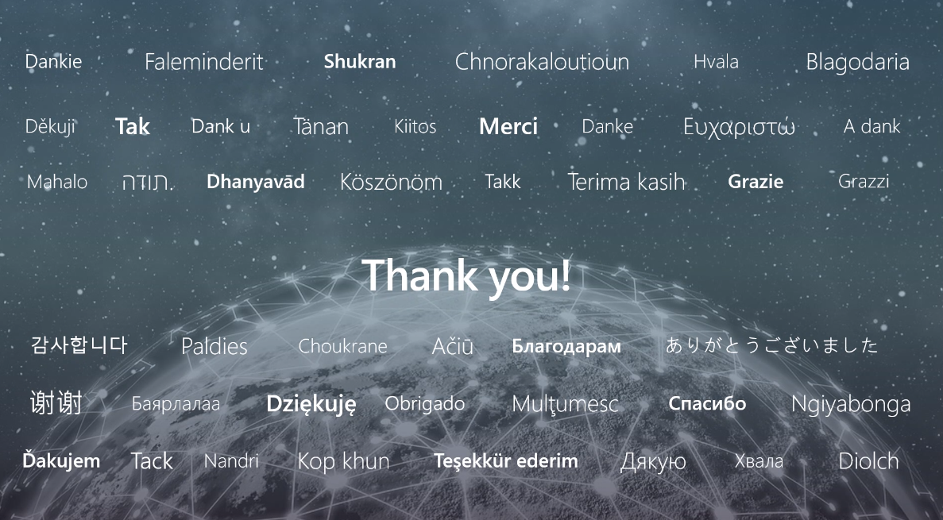

Slide 17
Microsoft

